Slide 1
Deep Learning-Based Dental X-Ray Diagnosis and Classification
Ali Saeed Dubai
Assist. Alaa Jassim Abd

Slide 2
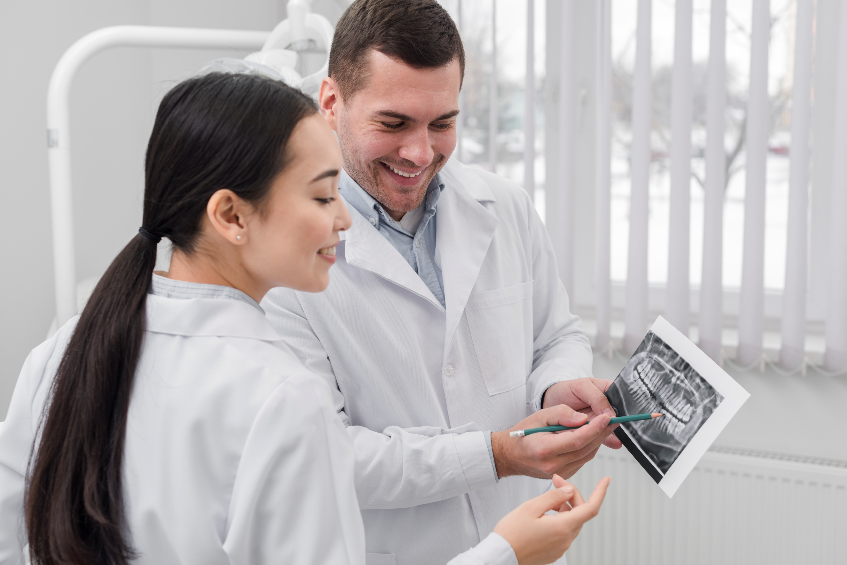
Problem & Motivation
Dental X-ray interpretation requires expertise
Early detection improves treatment outcomes.
Manual analysis is time-consuming and prone to human errors.
AI can assist dentists by providing fast and accurate diagnosis.
Objective: Classify Periapical X-rays into 5 classes: Cavity, Fillings, Impacted Tooth, Implant, Normal.

Slide 3

Dataset & Preprocessing
Content:
  Dataset: Periapical dental X-ray images.
  Split: Train / Validation / Test.
  Classes Distribution: Normal dominant, Cavity & Impacted Tooth rare.
Preprocessing:
  Center crop → resize to 224×224
  Normalize pixel values → [0,1]
  Grayscale → RGB conversion
Data Augmentation: Flip, rotation ±3%, zoom ±5%

Slide 4
Model Architecture
Base Model: MobileNetV2 (pretrained on ImageNet)
Layers: Lambda normalization, data augmentation, MobileNetV2 feature extractor, GAP, Dense 512 + BatchNorm + Dropout, Output 5-class Softmax
Optimizer: Adam, Loss: Sparse Categorical Crossentropy
Training Strategy:
  Phase 1: Train head only (base frozen)
  Phase 2: Fine-tune top layers (low LR)
  Callbacks: ModelCheckpoint, ReduceLROnPlateau

Slide 5
Evaluation Metrics
Overall Performance:
  Accuracy: 90%
  Weighted F1-score: 0.90
  Macro F1-score: 0.66
Class | F1-score
Cavity | 0.17
Fillings | 0.82
Impacted Tooth | 0.51
Implant | 0.86
Normal | 0.94
Notes: Macro F1 lower due to rare classes.

Slide 6
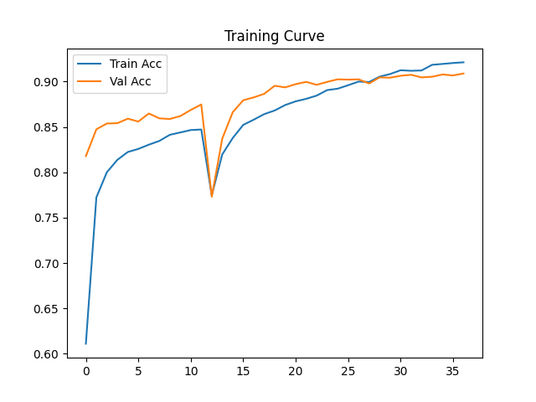
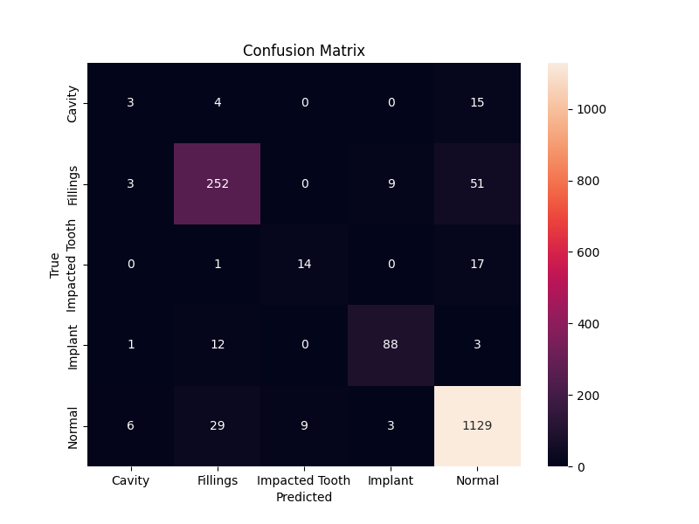
Phase 2: Fine-tune top layers (low LR)

Slide 7
Techniques & Improvements
Transfer Learning (MobileNetV2)
Data Augmentation for generalization
Fine-tuning top layers of base model
ReduceLROnPlateau → adaptive learning rate
Checkpoint → save best model
Normalization & RGB conversion for pretrained compatibility

Slide 8
Conclusion & Future Work
Successfully classified periapical X-rays with +95% accuracy
Strong performance on majority classes; weaknesses in rare classes (Cavity, Impacted Tooth)
Demonstrates feasibility of AI-assisted dental diagnosis
Integration with dental clinic software
Expansion to detect 10+ dental conditions

Slide 9
Sources
Deep Learning for Caries Detection and Classification – PubMed
MDPI - Publisher of Open Access Journals
Detection of Proximal Caries Lesions on Bitewing Radiographs Using Deep Learning Method – PubMed
Classification of Dental Radiographs Using Deep Learning

